Slide 1
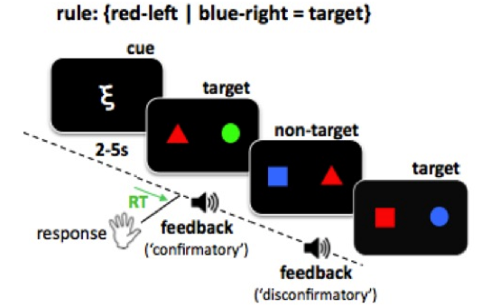
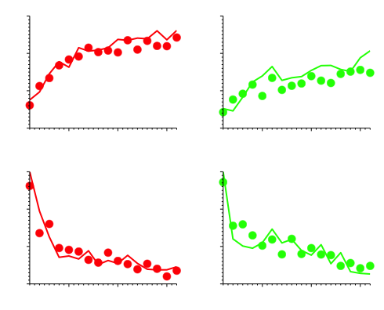
A
B
Familiar
Novel
100%
80%
% accuracy
60%
40%
1
5
10
15
1
5
10
15
100%
80%
% choose target
60%
40%
1
5
10
15
1
5
10
15
trial
trial

